Slide 1
11
Operator
Overloading;
String and Array
Objects

Slide 2
The whole difference between construction and creation is exactly this:
that a thing constructed can only be loved after it is constructed; but a thing created is loved before it exists.
  Gilbert Keith Chesterton
The die is cast.
  Julius Caesar
Our doctor would never really operate unless it was necessary. He was just that way. If he didn’t need the money, he wouldn’t lay a hand on you.
  Herb Shriner

Slide 3
OBJECTIVES
In this chapter you’ll learn:
What operator overloading is and how it makes programs more readable and programming more convenient.
To redefine (overload) operators to work with objects of user-defined classes.
The differences between overloading unary and binary operators.
To convert objects from one class to another class.
When to, and when not to, overload operators.
To create PhoneNumber, Array, String and Date classes that demonstrate operator overloading.
To use overloaded operators and other member functions of standard library class string.
To use keyword explicit to prevent the compiler from using single-argument constructors to perform implicit conversions.

Slide 4
11.1 Introduction
11.2 Fundamentals of Operator Overloading
11.3 Restrictions on Operator Overloading
11.4 Operator Functions as Class Members vs. Global Functions
11.5 Overloading Stream Insertion and Stream Extraction Operators
11.6 Overloading Unary Operators
11.7 Overloading Binary Operators
11.8 Case Study: Array Class
11.9 Converting between Types
11.10 Case Study: String Class
11.11 Overloading ++ and --
11.12 Case Study: A Date Class
11.13 Standard Library Class string
11.14 explicit Constructors
11.15 Wrap-Up

Slide 5
11.1 Introduction
Use operators with objects (operator overloading)
  Clearer than function calls for certain classes
  Operator sensitive to context
Examples
  <<
    Stream insertion, bitwise left-shift
  +
    Performs arithmetic on multiple items (integers, floats, etc.)

Slide 6
11.2 Fundamentals of Operator Overloading
Types for operator overloading
  Built in (int, char) or user-defined (classes)
  Can use existing operators with user-defined types
    Cannot create new operators
Overloading operators
  Create a function for the class
  Name of operator function
    Keyword operator followed by symbol
      Example
        operator+ for the addition operator +

Slide 7
Software Engineering Observation 11.1
Operator overloading contributes to C++’s extensibility—one of the language’s most appealing attributes.

Slide 8
Good Programming Practice 11.1
Use operator overloading when it makes a program clearer than accomplishing the same operations with function calls.

Slide 9
Good Programming Practice 11.2
Overloaded operators should mimic the functionality of their built-in counterparts—for example, the + operator should be overloaded to perform addition, not subtraction. Avoid excessive or inconsistent use of operator overloading, as this can make a program cryptic and difficult to read.

Slide 10
11.2 Fundamentals of Operator Overloading (Cont.)
Using operators on a class object
  It must be overloaded for that class
    Exceptions: (can also be overloaded by the programmer)
      Assignment operator (=)
        Memberwise assignment between objects
      Address operator (&)
        Returns address of object
      Comma operator (,)
        Evaluates expression to its left then the expression to its right
        Returns the value of the expression to its right
Overloading provides concise notation
  object2 = object1.add( object2 );
  vs.
  object2 = object2 + object1;

Slide 11
11.3 Restrictions on Operator Overloading
Cannot change
  Precedence of operator (order of evaluation)
    Use parentheses to force order of operators
  Associativity (left-to-right or right-to-left)
  Number of operands
    e.g., & is unary, can only act on one operand
  How operators act on built-in data types (i.e., cannot change integer addition)
Cannot create new operators
Operators must be overloaded explicitly
  Overloading + and = does not overload +=
Operator ?: cannot be overloaded

Slide 12
Common Programming Error 11.1
Attempting to overload a nonoverloadable operator is a syntax error.

Slide 13
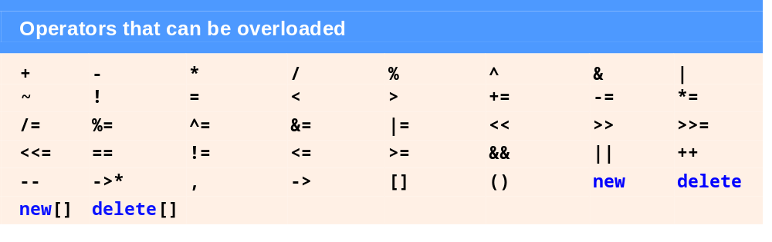
Fig. 11.1 | Operators that can be overloaded.

Slide 14

Fig. 11.2 | Operators that cannot be overloaded.

Slide 15
Common Programming Error 11.2
Attempting to change the “arity” of an operator via operator overloading is a compilation error.

Slide 16
Common Programming Error 11.3
Attempting to create new operators via operator overloading is a syntax error.

Slide 17
Software Engineering Observation 11.2
At least one argument of an operator function must be an object or reference of a user-defined type. This prevents programmers from changing how operators work on fundamental types.

Slide 18
Common Programming Error 11.4
Attempting to modify how an operator works with objects of fundamental types is a compilation error.

Slide 19
Common Programming Error 11.5
Assuming that overloading an operator such as + overloads related operators such as += or that overloading == overloads a related operator like != can lead to errors. Operators can be overloaded only explicitly; there is no implicit overloading.

Slide 20
11.4 Operator Functions as Class Members vs. Global Members
Operator functions
  As member functions
    Leftmost object must be of same class as operator function
    Use this keyword to implicitly get left operand argument
    Operators (), [], -> or any assignment operator must be overloaded as a class member function
    Called when
      Left operand of binary operator is of this class
      Single operand of unary operator is of this class
  As global functions
    Need parameters for both operands
    Can have object of different class than operator
    Can be a friend to access private or protected data

Slide 21
11.4 Operator Functions as Class Members vs. Global Members (Cont.)
Overloaded << operator
  Left operand of type ostream &
    Such as cout object in cout << classObject
  Similarly, overloaded >> has left operand of istream &
  Thus, both must be global functions

Slide 22
Performance Tip 11.1
It is possible to overload an operator as a global, non-friend function, but such a function requiring access to a class’s private or protected data would need to use set or get functions provided in that class’s public interface. The overhead of calling these functions could cause poor performance, so these functions can be inlined to improve performance.

Slide 23
11.4 Operator Functions as Class Members vs. Global Members (Cont.)
Commutative operators
  May want + to be commutative
    So both “a + b” and “b + a” work
  Suppose we have two different classes
    Overloaded operator can only be member function when its class is on left
      HugeIntClass + long int
        Can be member function
    When other way, need a global overloaded function
      long int + HugeIntClass

Slide 24
11.5 Overloading Stream Insertion and Stream Extraction Operators
<< and >> operators
  Already overloaded to process each built-in type
  Can also process a user-defined class
    Overload using global, friend functions
Example program
  Class PhoneNumber
    Holds a telephone number
  Print out formatted number automatically
    (123) 456-7890

Slide 25
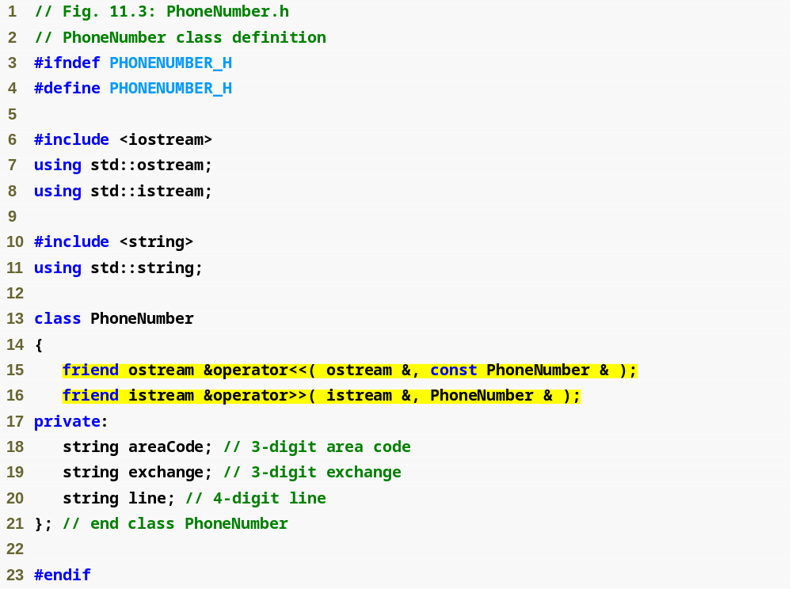
Outline
PhoneNumber.h
(1 of 1)
Notice function prototypes for overloaded operators >> and << (must be global, friend functions)

Slide 26
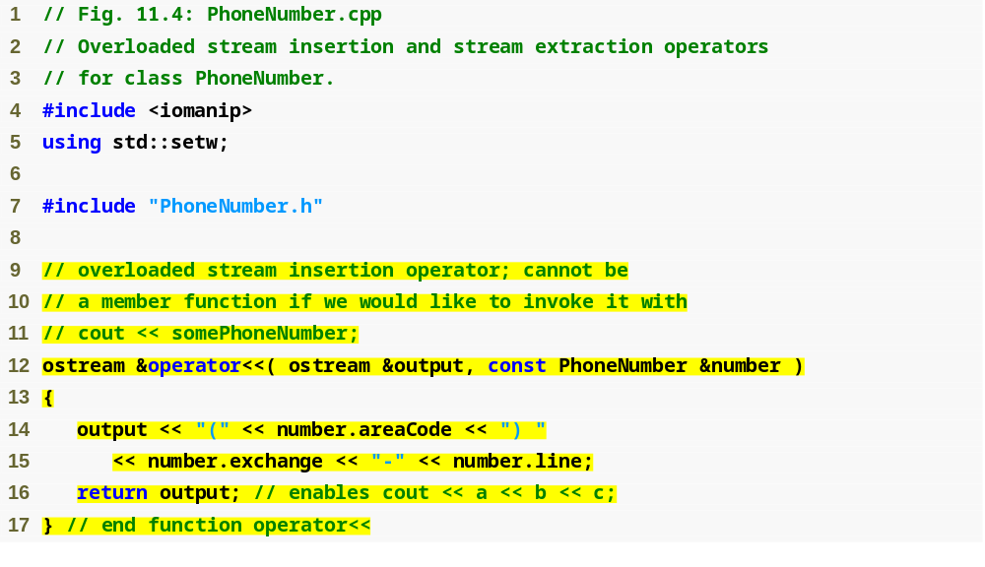
Outline
Allows cout << phone; to be interpreted as: operator<<(cout, phone);
PhoneNumber.cpp
(1 of 2)
Display formatted phone number

Slide 27
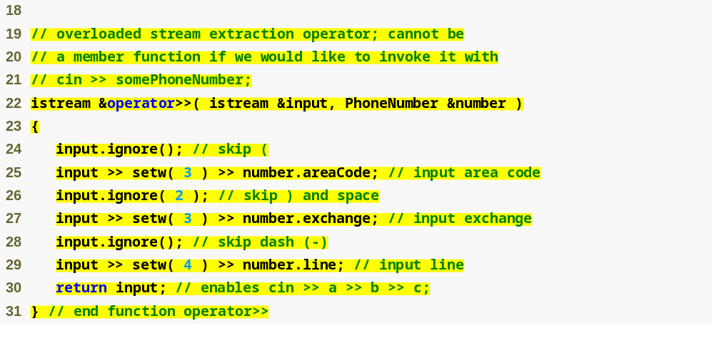
Outline
ignore skips specified number of characters from input (1 by default)
PhoneNumber.cpp
(2 of 2)
Input each portion of phone number separately

Slide 28
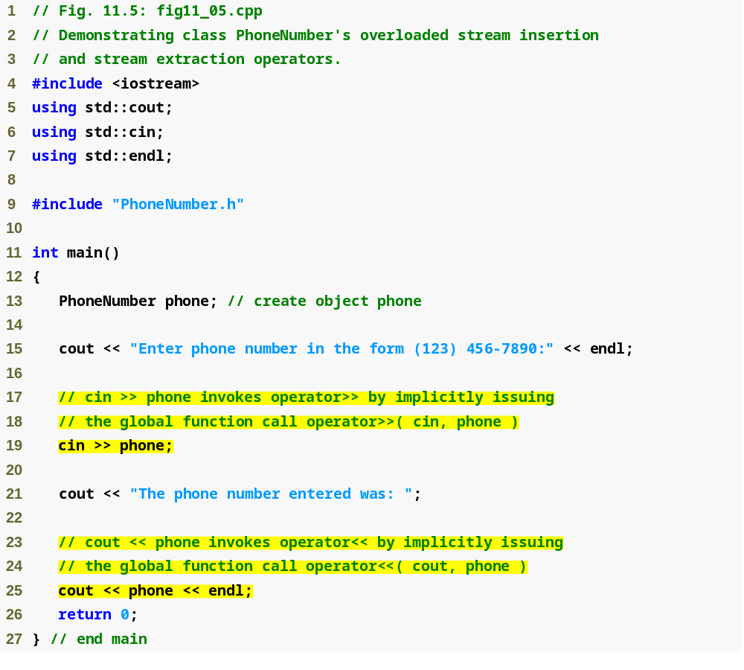
Outline
fig11_05.cpp
(1 of 2)
Testing overloaded >> and << operators to input and output a PhoneNumber object

Slide 29

Outline
fig11_05.cpp
(2 of 2)

Slide 30
Error-Prevention Tip 11.1
Returning a reference from an overloaded << or >> operator function is typically successful because cout, cin and most stream objects are global, or at least long-lived. Returning a reference to an automatic variable or other temporary object is dangerous—creating “dangling references” to nonexisting objects.

Slide 31
Software Engineering Observation 11.3
New input/output capabilities for user-defined types are added to C++ without modifying C++’s standard input/output library classes. This is another example of C++’s extensibility.

Slide 32
11.6 Overloading Unary Operators
Overloading unary operators
  Can overload as non-static member function with no arguments
  Can overload as global function with one argument
    Argument must be class object or reference to class object
  Remember, static functions only access static data

Slide 33
11.6 Overloading Unary Operators (Cont.)
Upcoming example (Section 11.10)
  Overload ! to test for empty string
  If non-static member function, needs no arguments
    class String
    {
    public:
    bool operator!() const;
    …
    };
    !s becomes s.operator!()
  If global function, needs one argument
    bool operator!( const String & )
    s! becomes operator!(s)

Slide 34
11.7 Overloading Binary Operators
Overloading binary operators
  Non-static member function, one argument
  Global function, two arguments
    One argument must be class object or reference

Slide 35
11.7 Overloading Binary Operators (Cont.)
Upcoming example: Overloading +=
  If non-static member function, needs one argument
    class String
    {
    public:
    const String & operator+=( const String & );
    …
    };
    y += z becomes y.operator+=( z )
  If global function, needs two arguments
    const String &operator+=( String &, const String & );
    y += z becomes operator+=( y, z )

Slide 36
11.8 Case Study: Array Class
Pointer-based arrays in C++
  No range checking
  Cannot be compared meaningfully with ==
  No array assignment (array names are const pointers)
  If array passed to a function, size must be passed as a separate argument
Example: Implement an Array class with
  Range checking
  Array assignment
  Arrays that know their own size
  Outputting/inputting entire arrays with << and >>
  Array comparisons with == and !=

Slide 37
11.8 Case Study: Array Class (Cont.)
Copy constructor
  Used whenever copy of object is needed:
    Passing by value (return value or parameter)
    Initializing an object with a copy of another of same type
      Array newArray( oldArray ); or
      Array newArray = oldArray (both are identical)
        newArray is a copy of oldArray
  Prototype for class Array
    Array( const Array & );
    Must take reference
      Otherwise, the argument will be passed by value…
      Which tries to make copy by calling copy constructor…
        Infinite loop

Slide 38
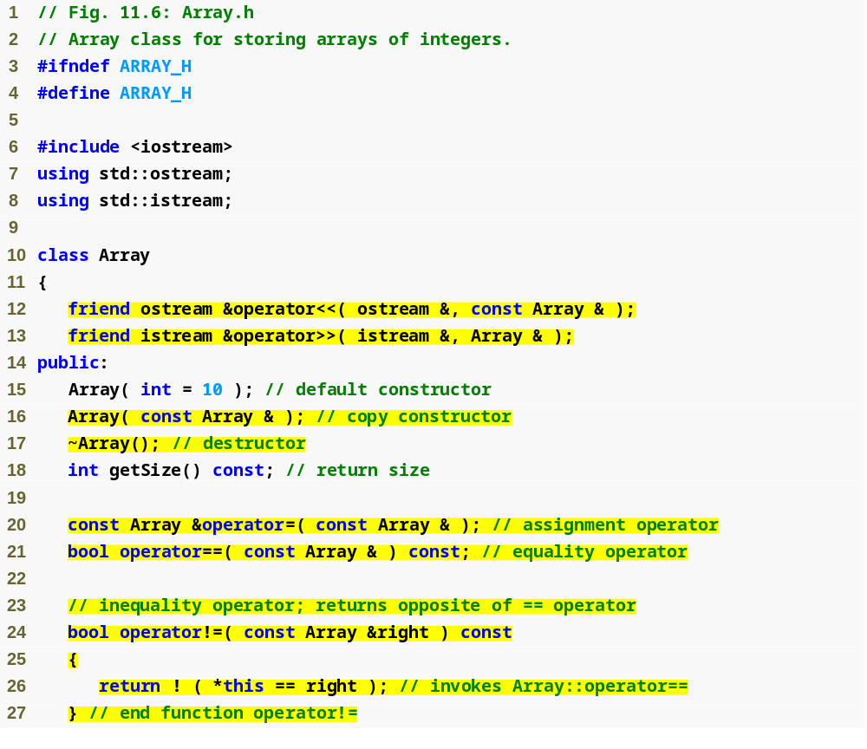
Outline
Array.h
(1 of 2)
Most operators overloaded as member functions (except << and >>, which must be global functions)
Prototype for copy constructor
!= operator simply returns opposite of == operator – only need to define the == operator

Slide 39
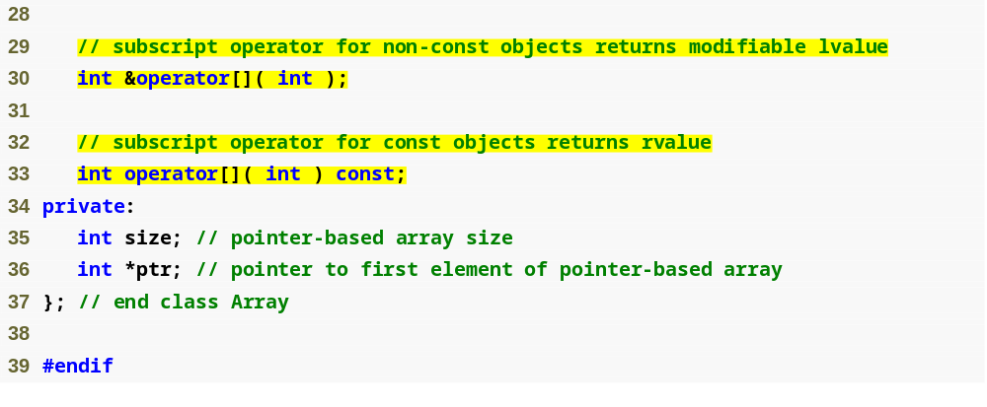
Outline
Array.h
(2 of 2)
Operators for accessing specific elements of Array object

Slide 40
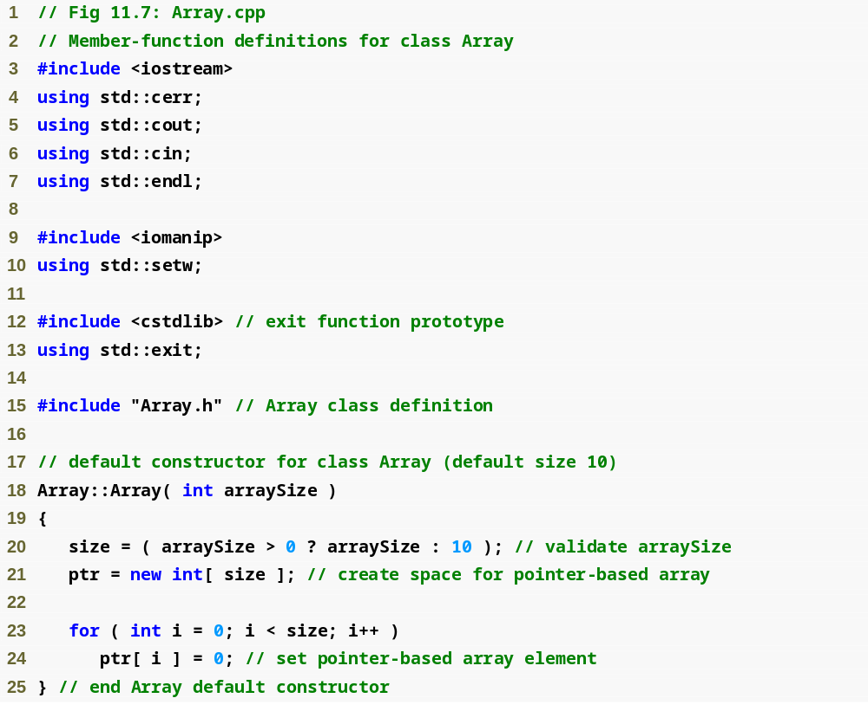
Outline
Array.cpp
(1 of 6)

Slide 41
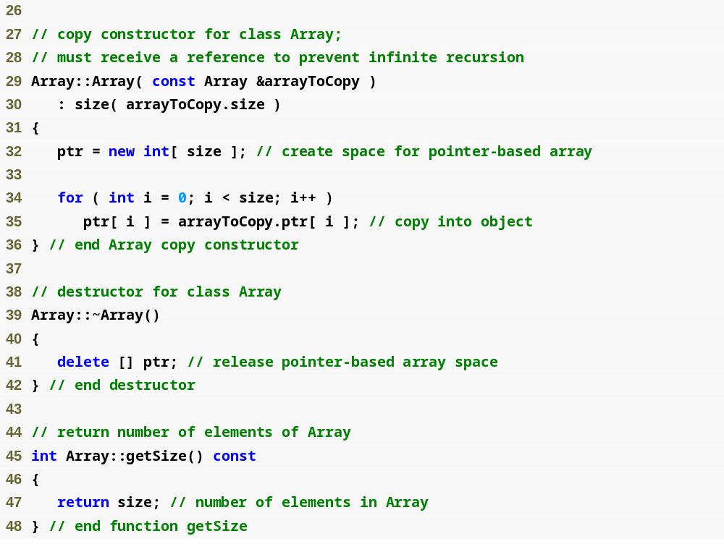
Outline
Array.cpp
(2 of 6)
We must declare a new integer array so the objects do not point to the same memory

Slide 42
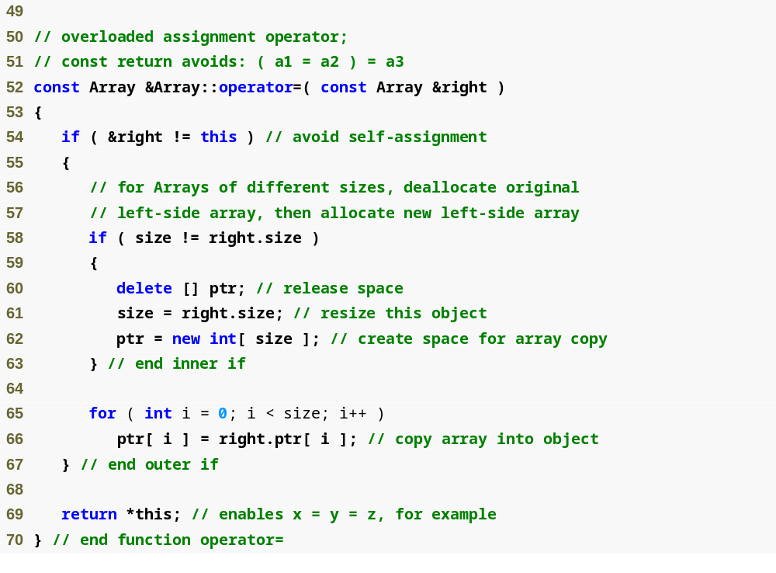
Outline
Array.cpp
(3 of 6)
Want to avoid self assignment
This would be dangerous if this is the same Array as right

Slide 43
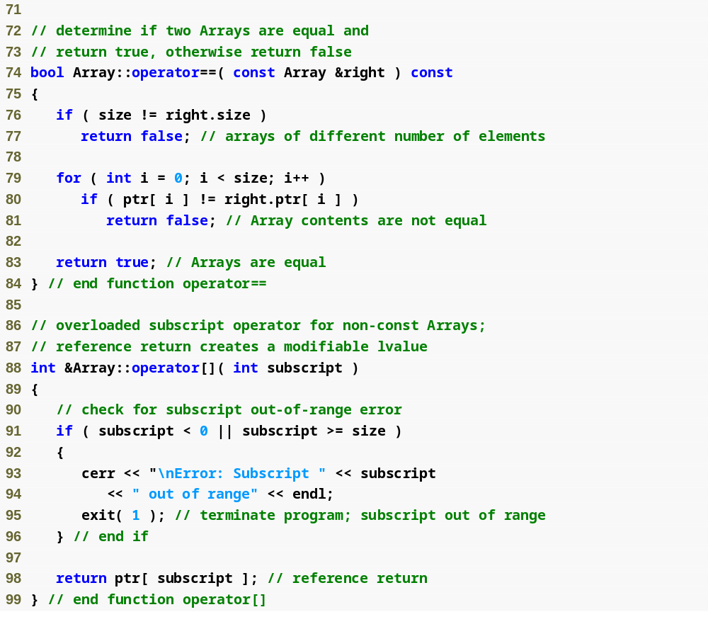
Outline
Array.cpp
(4 of 6)
integers1[ 5 ] calls integers1.operator[]( 5 )

Slide 44
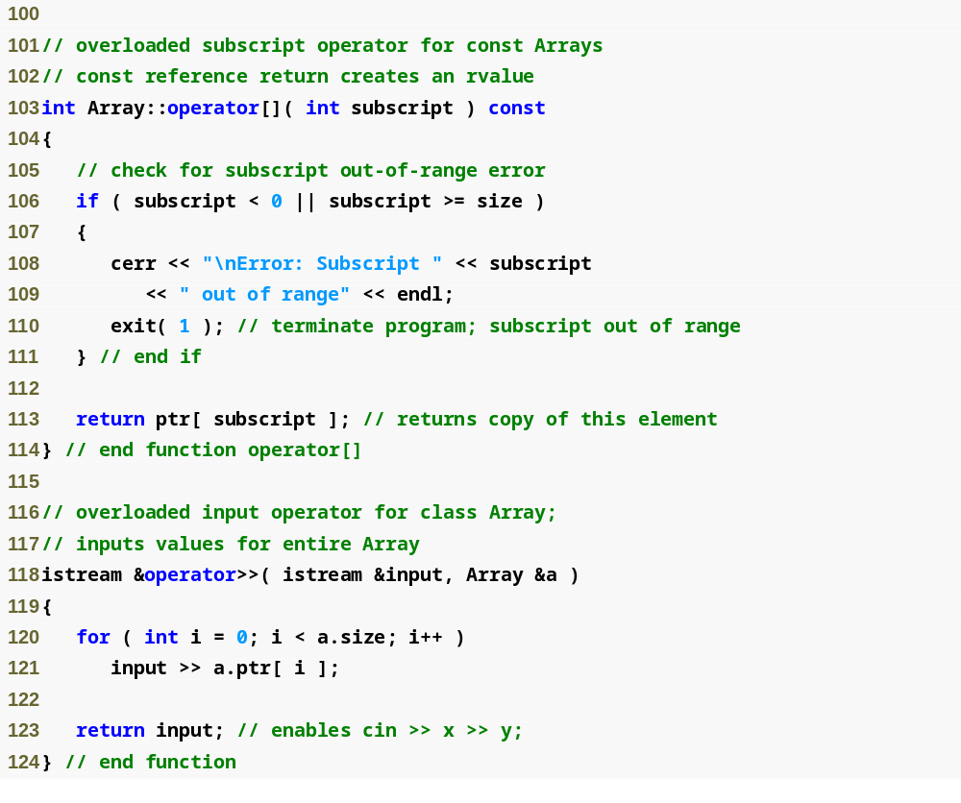
Outline
Array.cpp
(5 of 6)

Slide 45
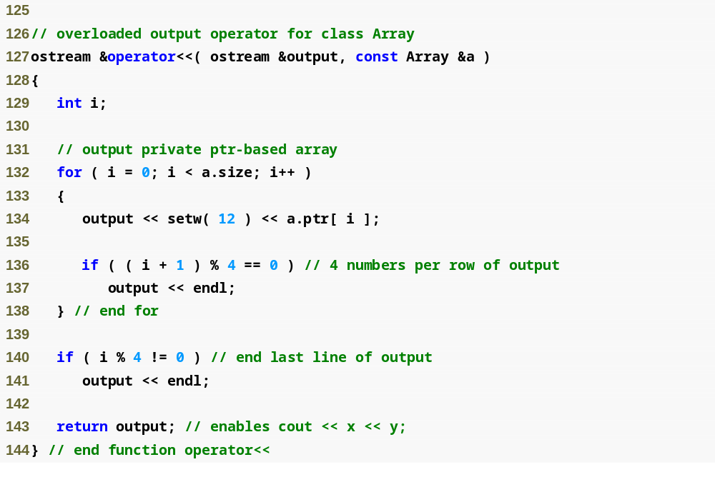
Outline
Array.cpp
(6 of 6)

Slide 46
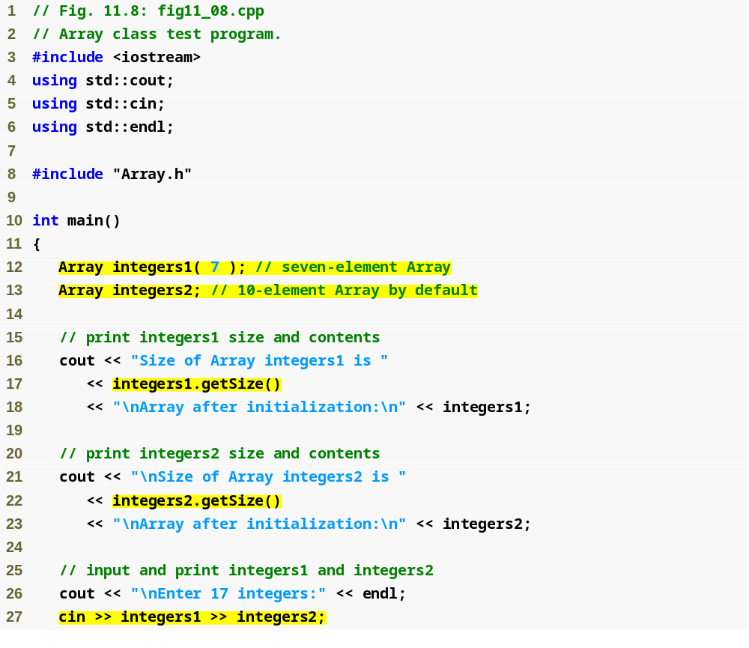
Outline
fig11_08.cpp
(1 of 5)
Retrieve number of elements in Array
Use overloaded >> operator to input

Slide 47
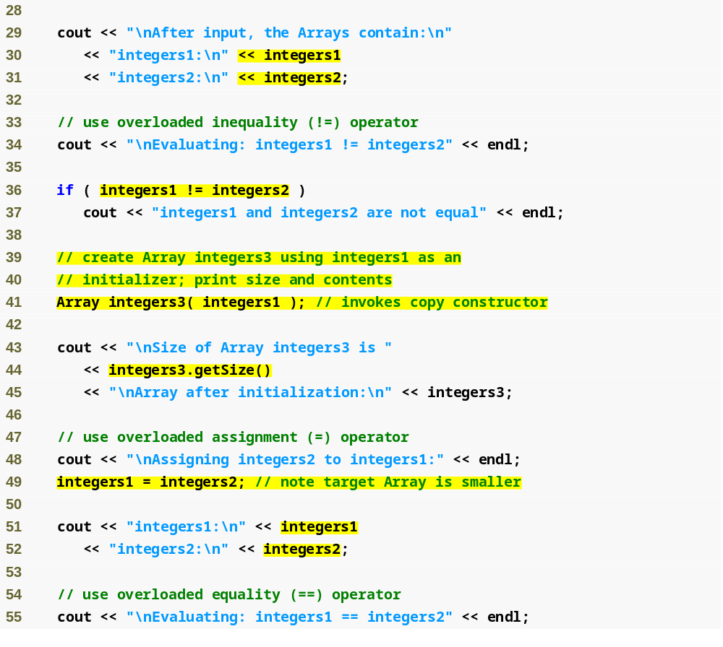
Outline
Use overloaded << operator to output
fig11_08.cpp
(2 of 5)
Use overloaded != operator to test for inequality
Use copy constructor
Use overloaded = operator to assign

Slide 48
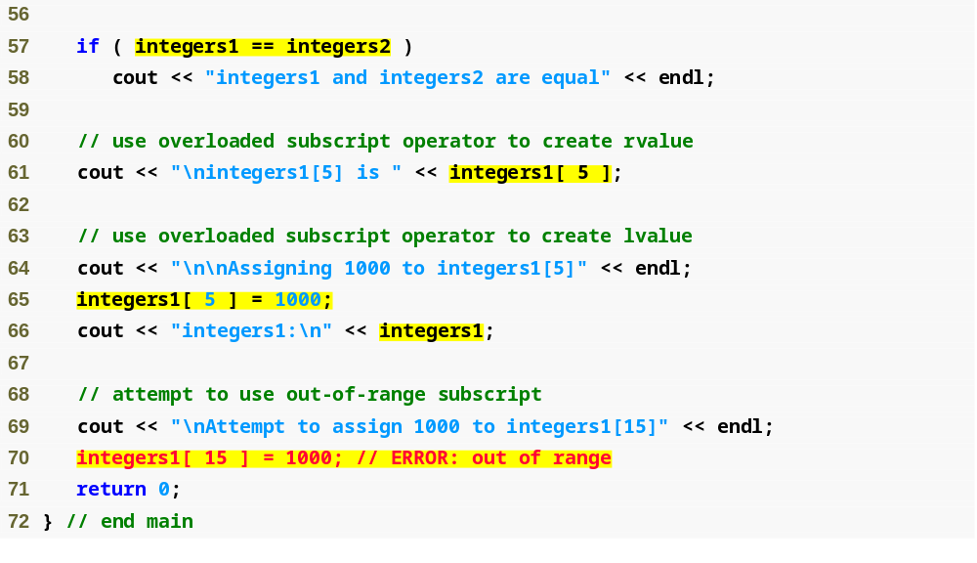
Use overloaded == operator to test for equality
Outline
fig11_08.cpp
(3 of 5)
Use overloaded [] operator to access individual integers, with range-checking

Slide 49
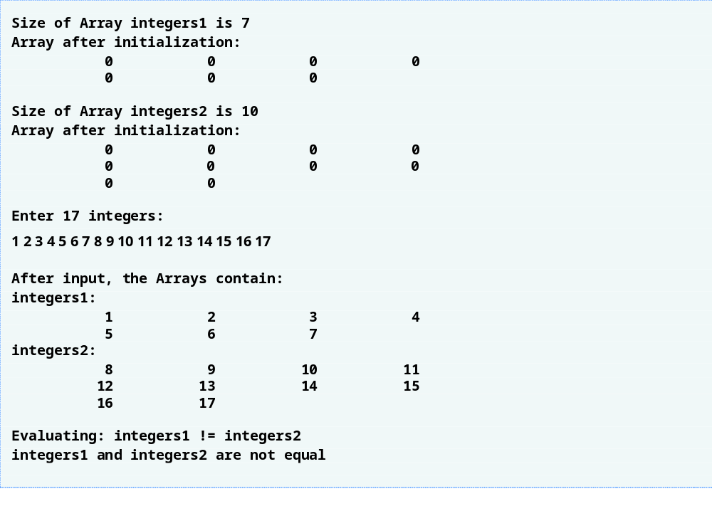
Outline
fig11_08.cpp
(4 of 5)

Slide 50
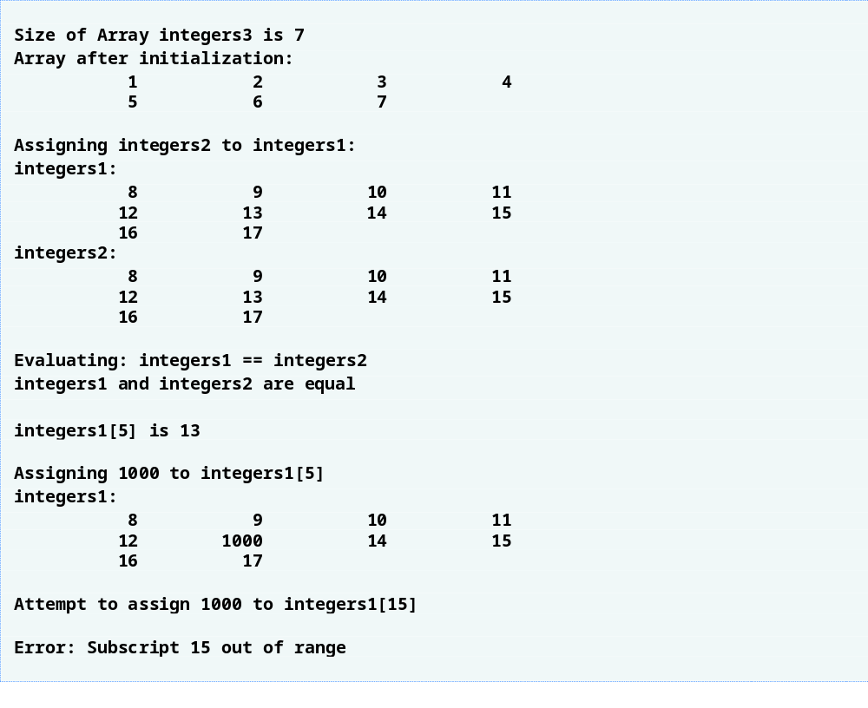
Outline
fig11_08.cpp
(5 of 5)

Slide 51
Software Engineering Observation 11.4
The argument to a copy constructor should be a const reference to allow a const object to be copied.

Slide 52
Common Programming Error 11.6
Note that a copy constructor must receive its argument by reference, not by value. Otherwise, the copy constructor call results in infinite recursion (a fatal logic error) because receiving an object by value requires the copy constructor to make a copy of the argument object. Recall that any time a copy of an object is required, the class’s copy constructor is called. If the copy constructor received its argument by value, the copy constructor would call itself recursively to make a copy of its argument!

Slide 53
Common Programming Error 11.7
If the copy constructor simply copied the pointer in the source object to the target object’s pointer, then both objects would point to the same dynamically allocated memory. The first destructor to execute would then delete the dynamically allocated memory, and the other object’s ptr would be undefined, a situation called a dangling pointer—this would likely result in a serious run-time error (such as early program termination) when the pointer was used.

Slide 54
Software Engineering Observation 11.5
A copy constructor, a destructor and an overloaded assignment operator are usually provided as a group for any class that uses dynamically allocated memory.

Slide 55
Common Programming Error 11.8
Not providing an overloaded assignment operator and a copy constructor for a class when objects of that class contain pointers to dynamically allocated memory is a logic error.

Slide 56
Software Engineering Observation 11.6
It is possible to prevent one object of a class from being assigned to another. This is done by declaring the assignment operator as a private member of the class.

Slide 57
Software Engineering Observation 11.7
It is possible to prevent class objects from being copied; to do this, simply make both the overloaded assignment operator and the copy constructor of that class private.

Slide 58
11.9 Converting between Types
Casting
  Traditionally, cast integers to floats, etc.
  May need to convert between user-defined types
Cast operator (conversion operator)
  Convert from
    One class to another
    A Class to a built-in type (int, char, etc.)
  Must be non-static member function
  Do not specify return type
    Implicitly returns type to which you are converting

Slide 59
11.9 Converting between Types (Cont.)
Cast operator (conversion operator) (Cont.)
  Example
    Prototype
      A::operator char *() const;
      Casts class A to a temporary char *
      static_cast< char * >( s ) calls
      s.operator char *()
    Also
      A::operator int() const;
      A::operator OtherClass() const;

Slide 60
11.9 Converting between Types (Cont.)
Casting can prevent need for overloading
  Suppose class String can be cast to char *
  cout << s; // s is a String
    Compiler implicitly converts s to char * for output
    Do not have to overload <<

Slide 61
11.10 Case Study: String Class
Build class String
  String creation, manipulation
  Similar to class string in standard library (Chapter 18)
Conversion constructor
  Any single-argument constructor
  Turns objects of other types into class objects
    Example
      String s1( "happy" );
        Creates a String from a char *
Overloading function call operator
  Powerful (functions can take arbitrarily long and complex parameter lists)

Slide 62
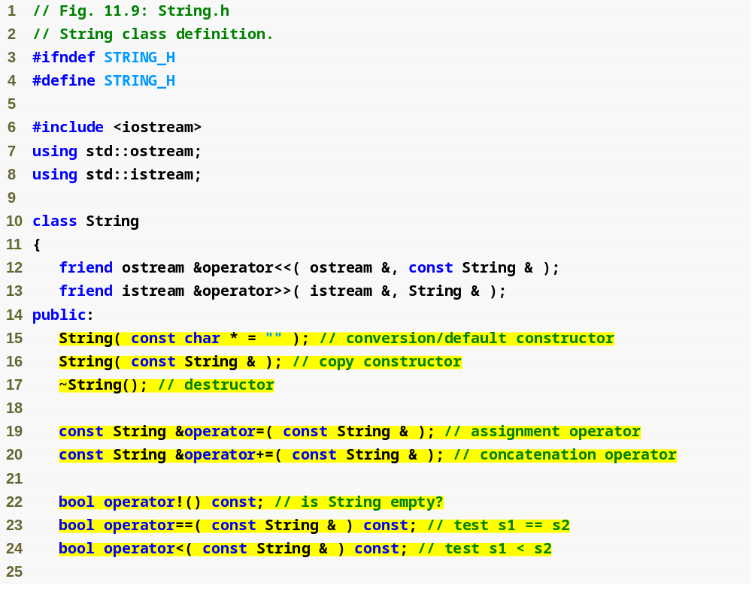
Outline
String.h
(1 of 3)
Conversion constructor to make a String from a char *
s1 += s2 will be interpreted as s1.operator+=(s2)
Can also concatenate a String and a char * because the compiler will cast the char * argument to a String

Slide 63
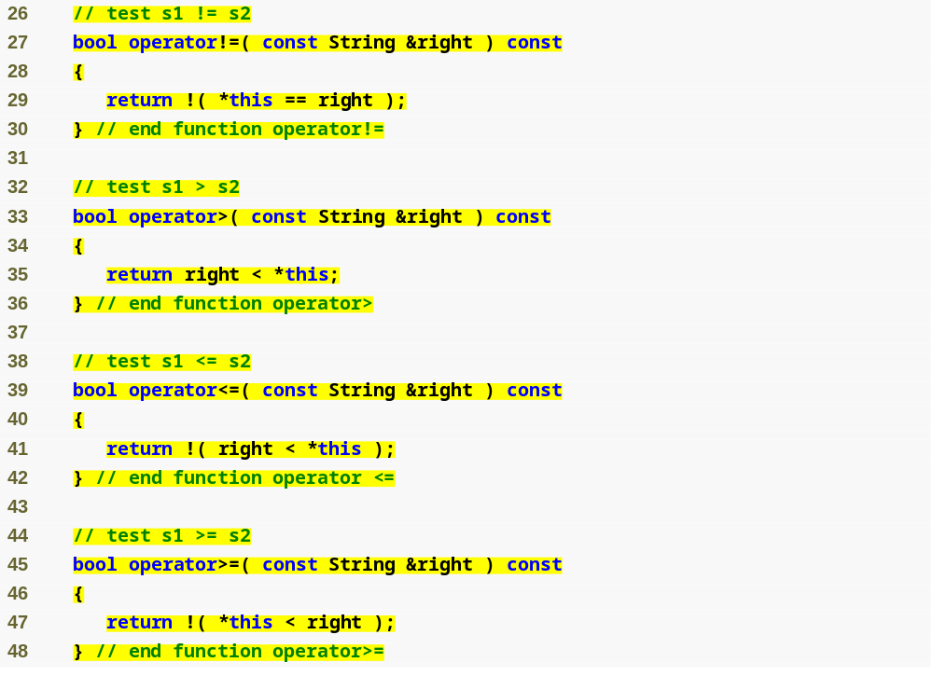
Outline
String.h
(2 of 3)
Overload equality and relational operators

Slide 64
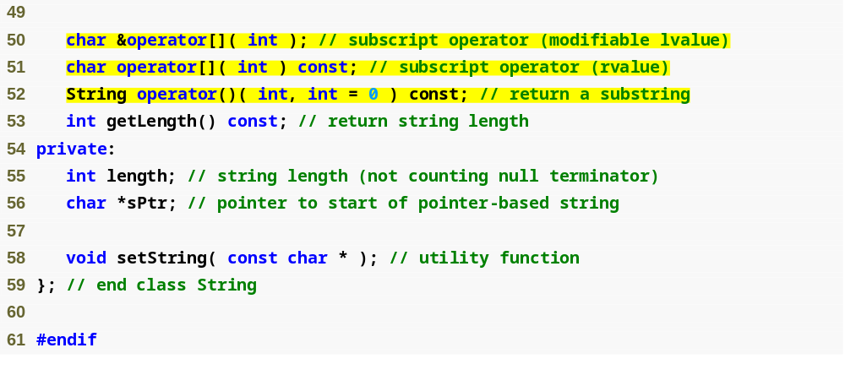
Outline
Two overloaded subscript operators, for const and non-const objects
String.h
(3 of 3)
Overload the function call operator () to return a substring

Slide 65
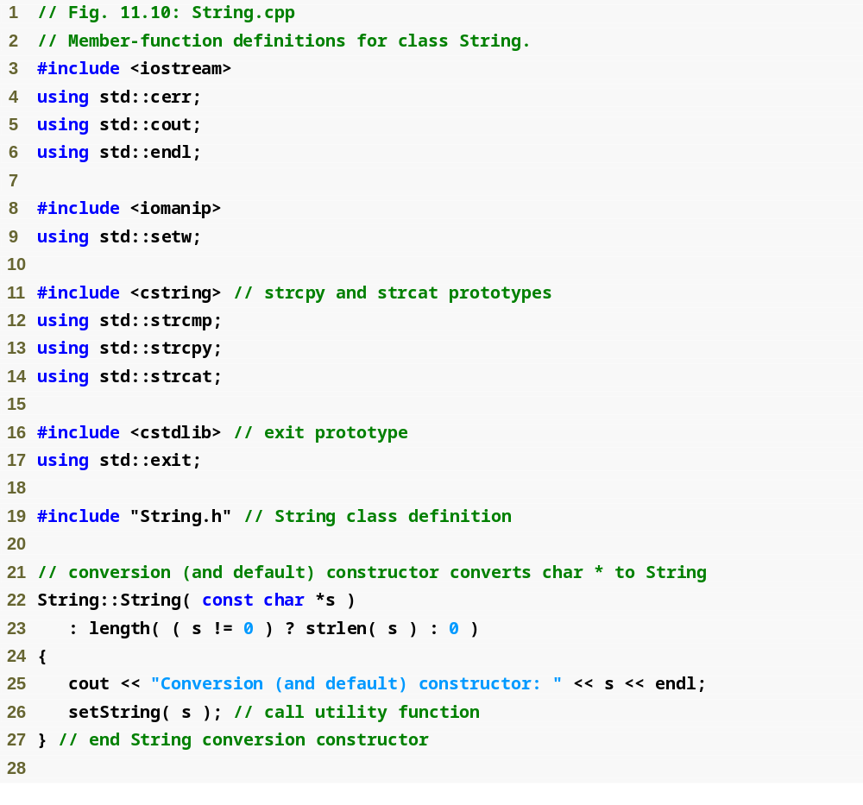
Outline
String.cpp
(1 of 7)

Slide 66
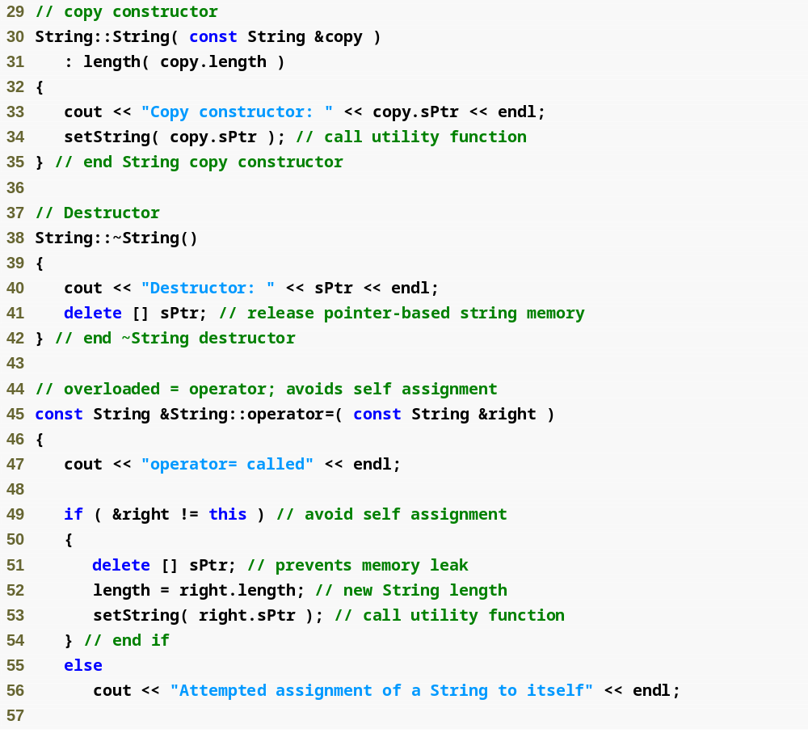
Outline
String.cpp
(2 of 7)

Slide 67
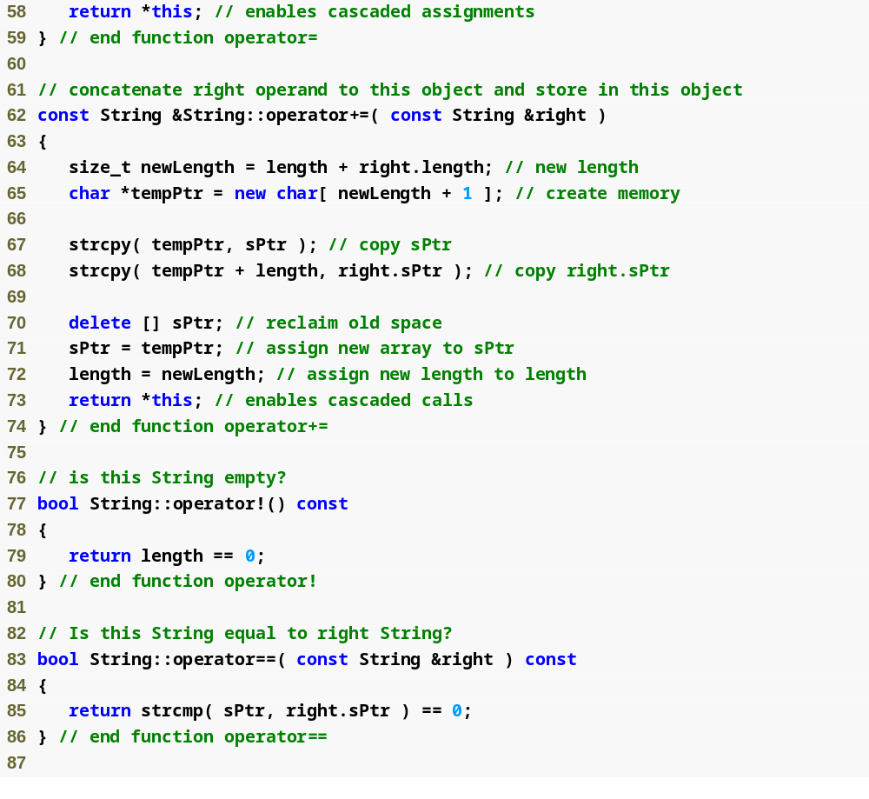
Outline
String.cpp
(3 of 7)

Slide 68
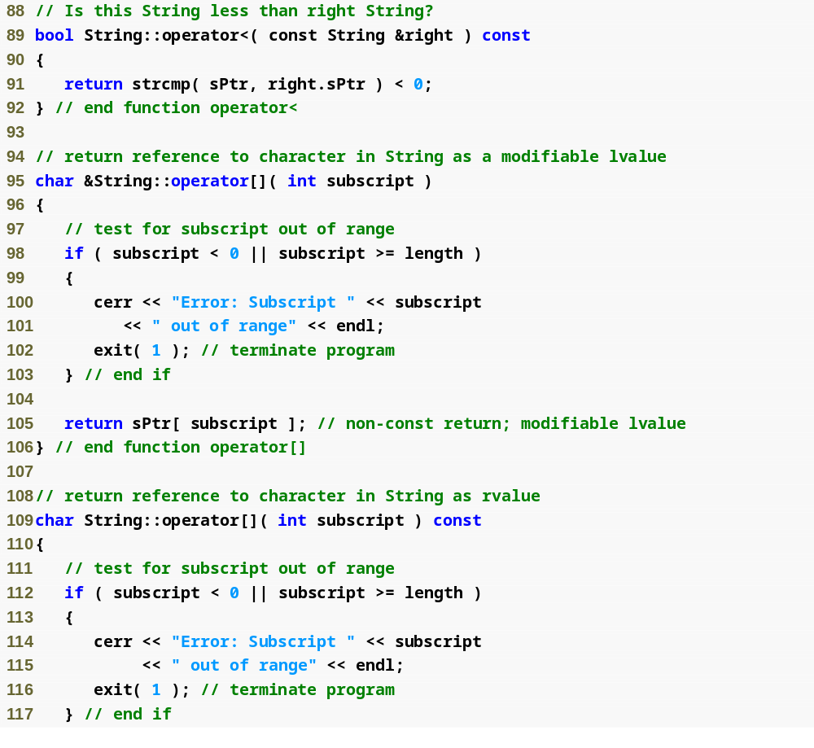
Outline
String.cpp
(4 of 7)

Slide 69
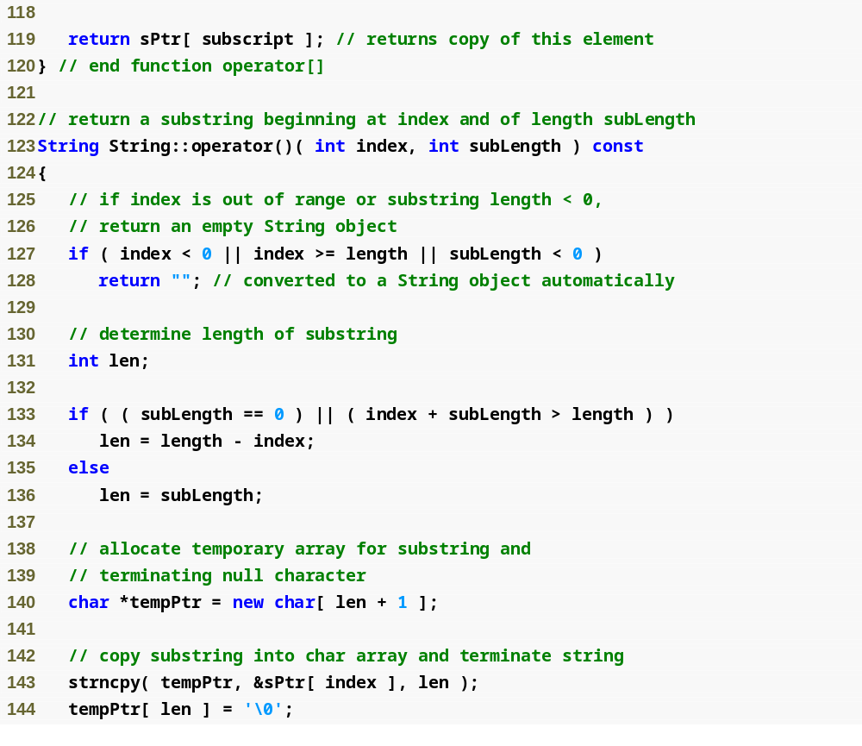
Outline
String.cpp
(5 of 7)

Slide 70
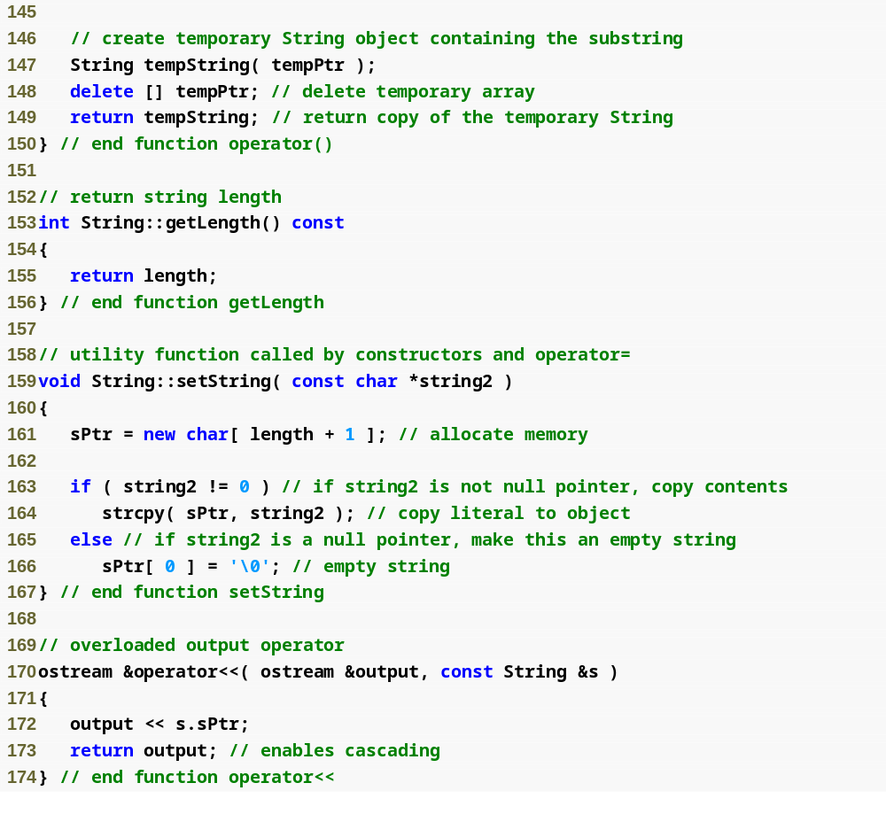
Outline
String.cpp
(6 of 7)

Slide 71
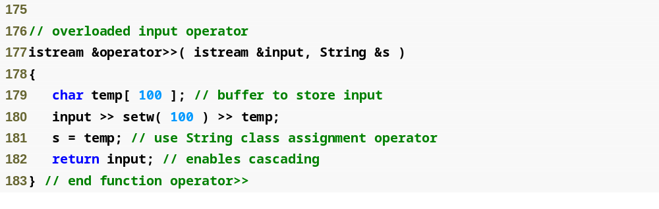
Outline
String.cpp
(7 of 7)

Slide 72
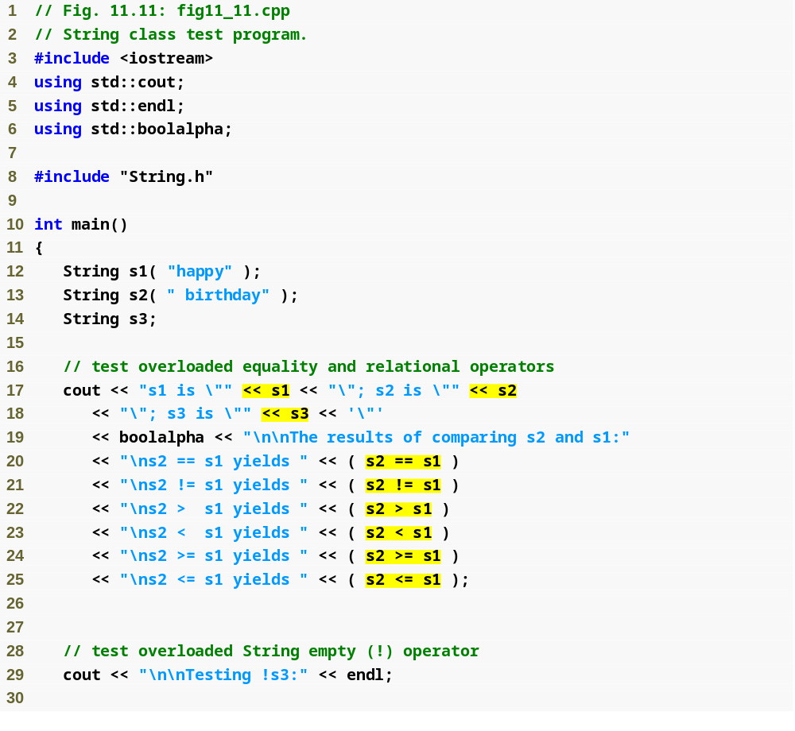
Outline
fig11_11.cpp
(1 of 5)
Use overloaded stream insertion operator for Strings
Use overloaded equality and relational operators for Strings

Slide 73
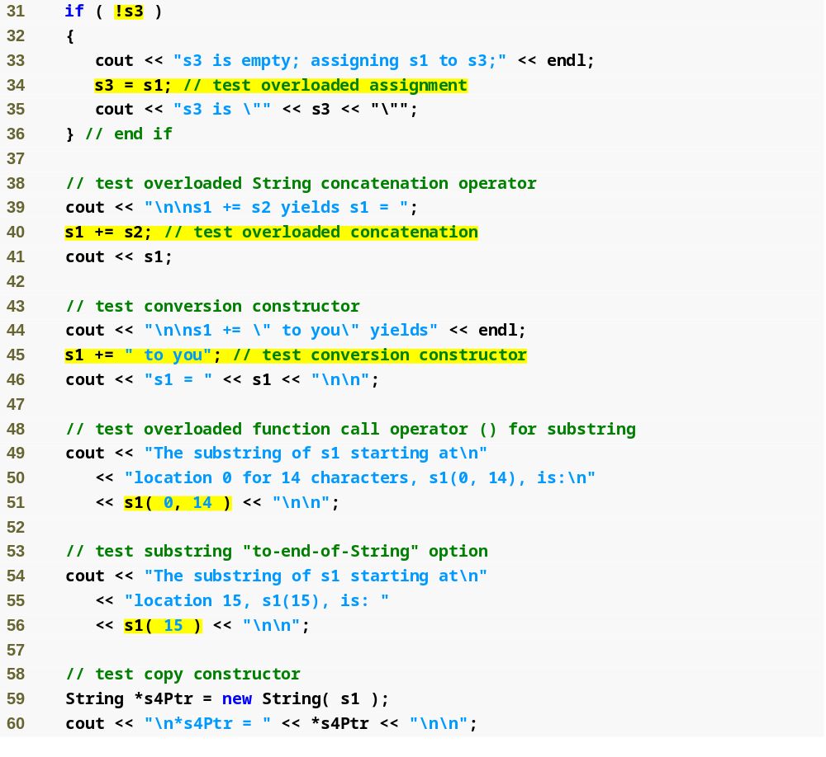
Use overloaded negation operator for Strings
Outline
Use overloaded assignment operator for Strings
fig11_11.cpp
(2 of 5)
Use overloaded addition assignment operator for Strings
char * string is converted to a String before using the overloaded addition assignment operator
Use overloaded function call operator for Strings

Slide 74
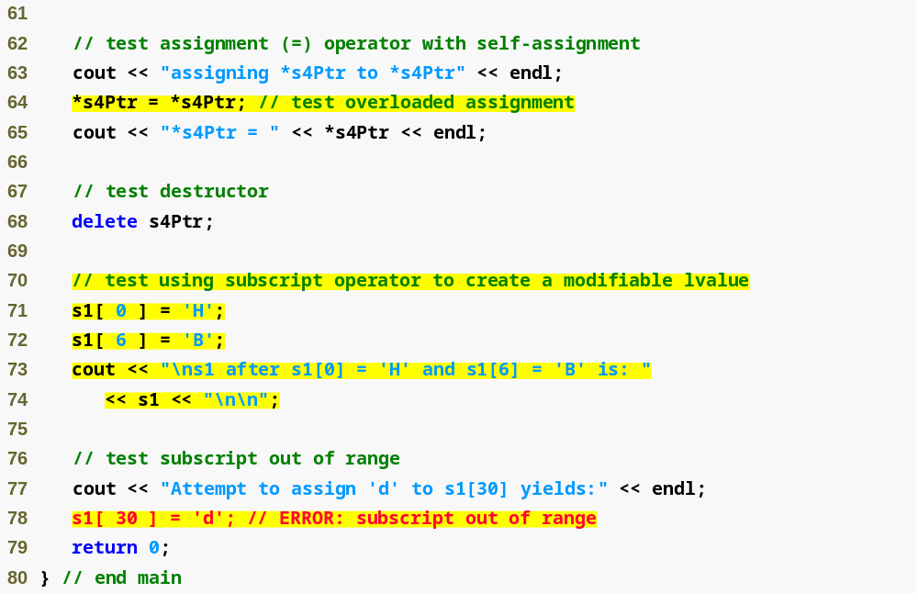
Outline
fig11_11.cpp
(3 of 5)
Use overloaded subscript operator for Strings
Attempt to access a subscript outside of the valid range

Slide 75
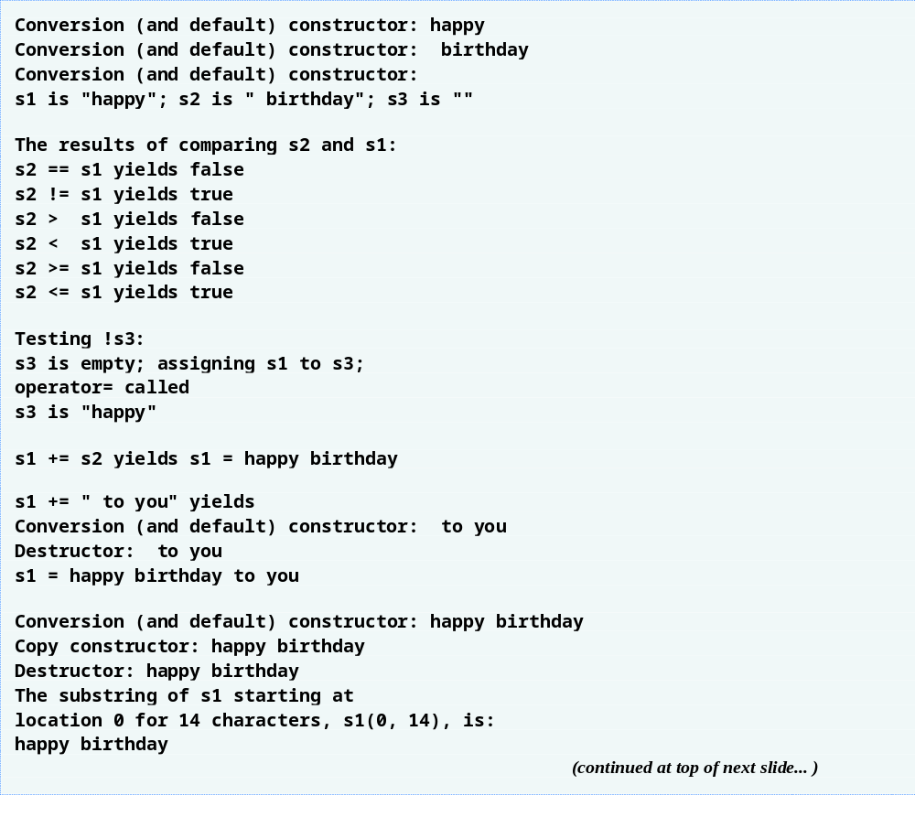
Outline
fig11_11.cpp
(4 of 5)
The constructor and destructor are called for the temporary String

Slide 76
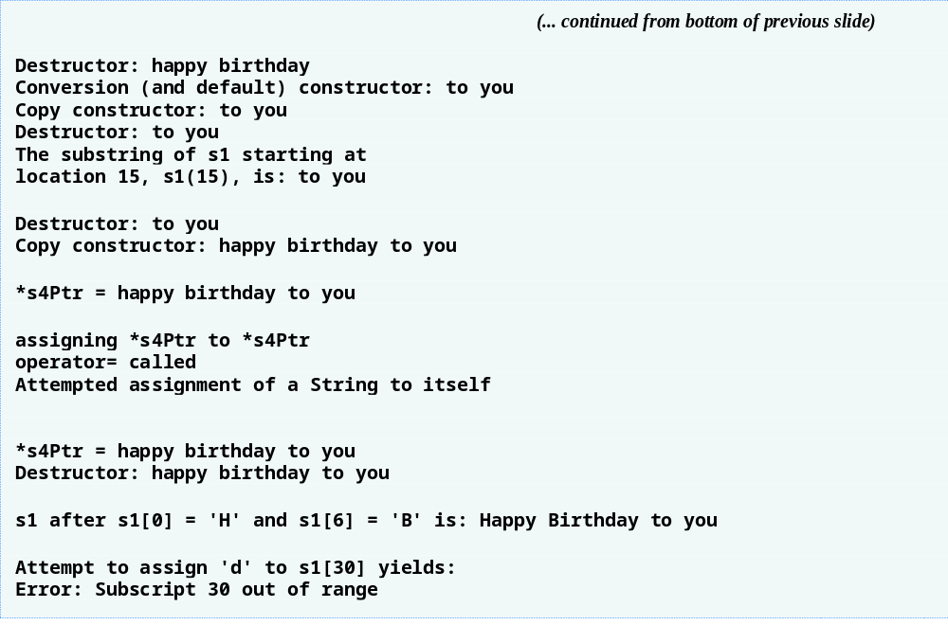
Outline
fig11_11.cpp
(5 of 5)

Slide 77
Software Engineering Observation 11.8
When a conversion constructor is used to perform an implicit conversion, C++ can apply only one implicit constructor call (i.e., a single user-defined conversion) to try to match the needs of another overloaded operator. The compiler will not match an overloaded operator’s needs by performing a series of implicit, user-defined conversions.

Slide 78
Performance Tip 11.2
Overloading the += concatenation operator with an additional version that takes a single argument of type const char * executes more efficiently than having only a version that takes a String argument. Without the const char * version of the += operator, a const char * argument would first be converted to a String object with class String’s conversion constructor, then the += operator that receives a String argument would be called to perform the concatenation.

Slide 79
Software Engineering Observation 11.9
Using implicit conversions with overloaded operators, rather than overloading operators for many different operand types, often requires less code, which makes a class easier to modify, maintain and debug.

Slide 80
Software Engineering Observation 11.10
By implementing member functions using previously defined member functions, the programmer reuses code to reduce the amount of code that must be written and maintained.

Slide 81
Error-Prevention Tip 11.2
Returning a non-const char reference from an overloaded subscript operator in a String class is dangerous. For example, the client could use this reference to insert a null ('\0') anywhere in the string.

Slide 82
11.11 Overloading ++ and --
Increment/decrement operators can be overloaded
  Suppose we want to add 1 to a Date object, d1
  Prototype (member function)
    Date &operator++();
    ++d1 becomes d1.operator++()
  Prototype (global function)
    Date &operator++( Date & );
    ++d1 becomes operator++( d1 )

Slide 83
11.11 Overloading ++ and -- (Cont.)
To distinguish prefix and postfix increment
  Postfix increment has a dummy parameter
    An int with value 0
  Prototype (member function)
    Date operator++( int );
    d1++ becomes d1.operator++( 0 )
  Prototype (global function)
    Date operator++( Date &, int );
    d1++ becomes operator++( d1, 0 )

Slide 84
11.11 Overloading ++ and -- (Cont.)
Return values
  Prefix increment
    Returns by reference (Date &)
    lvalue (can be assigned)
  Postfix increment
    Returns by value
      Returns temporary object with old value
    rvalue (cannot be on left side of assignment)
All this applies to decrement operators as well

Slide 85
Performance Tip 11.3
The extra object that is created by the postfix increment (or decrement) operator can result in a significant performance problem—especially when the operator is used in a loop. For this reason, you should use the postfix increment (or decrement) operator only when the logic of the program requires postincrementing (or postdecrementing).

Slide 86
11.12 Case Study: A Date Class
Example Date class
  Overloaded increment operator
    Change day, month and year
  Overloaded += operator
  Function to test for leap years
  Function to determine if day is last of month

Slide 87
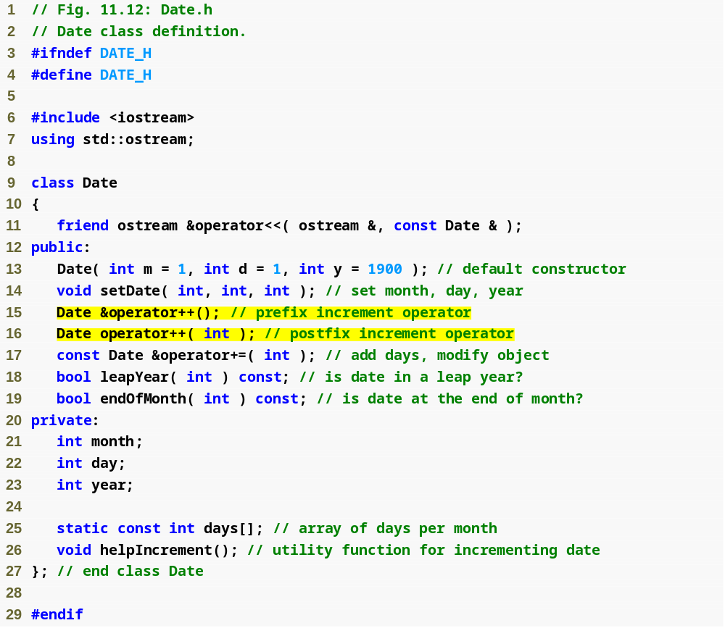
Outline
Date.h
(1 of 1)
Note the difference between prefix and postfix increment

Slide 88
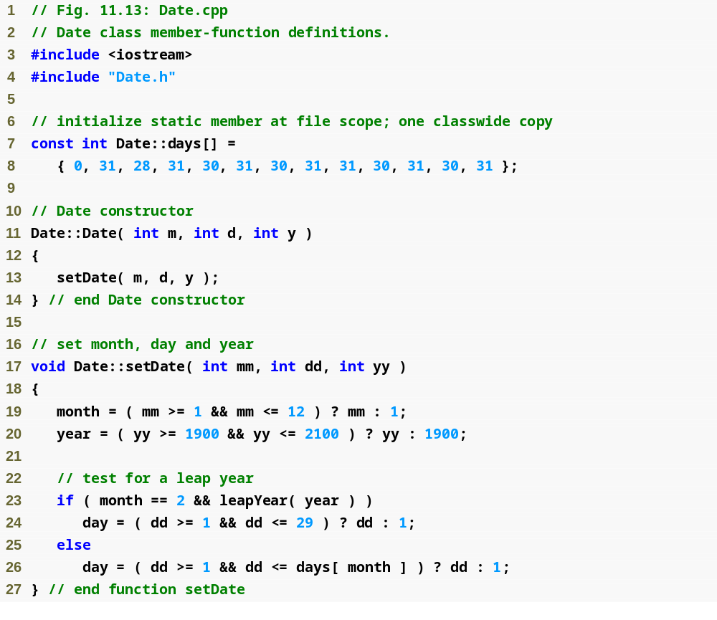
Outline
Date.cpp
(1 of 4)

Slide 89
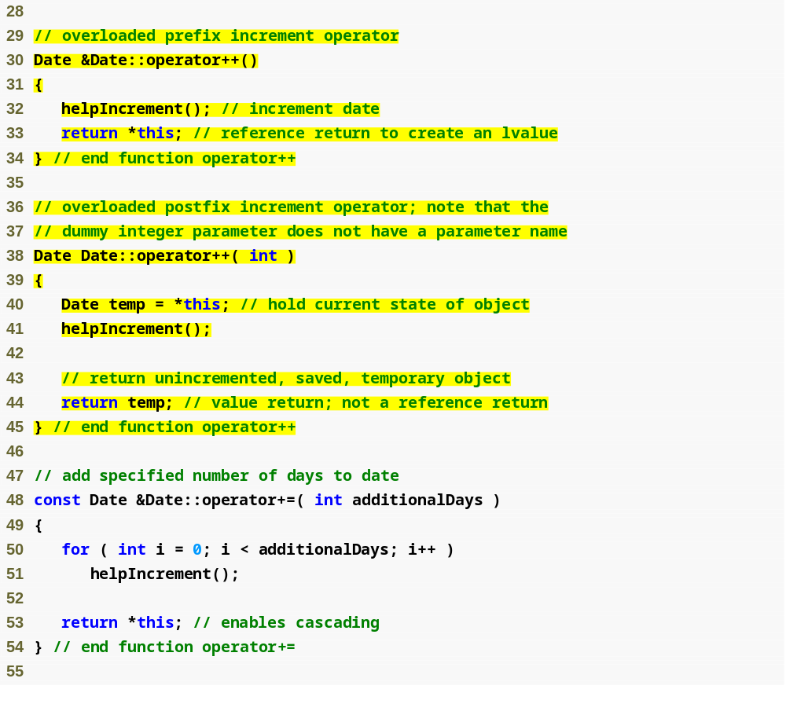
Outline
Date.cpp
(2 of 4)
Postfix increment updates object and returns a copy of the original
Do not return a reference to temp, because it is a local variable that will be destroyed

Slide 90
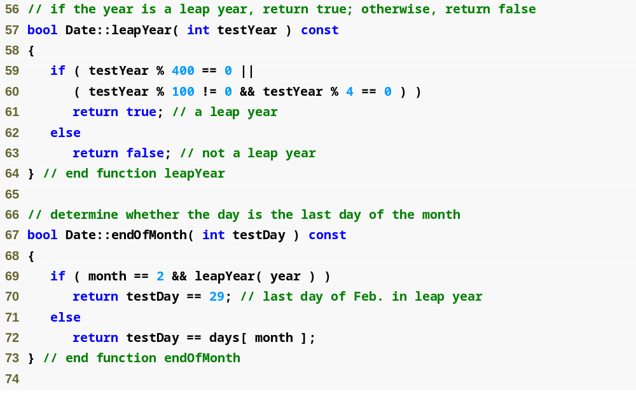
Outline
Date.cpp
(3 of 4)

Slide 91
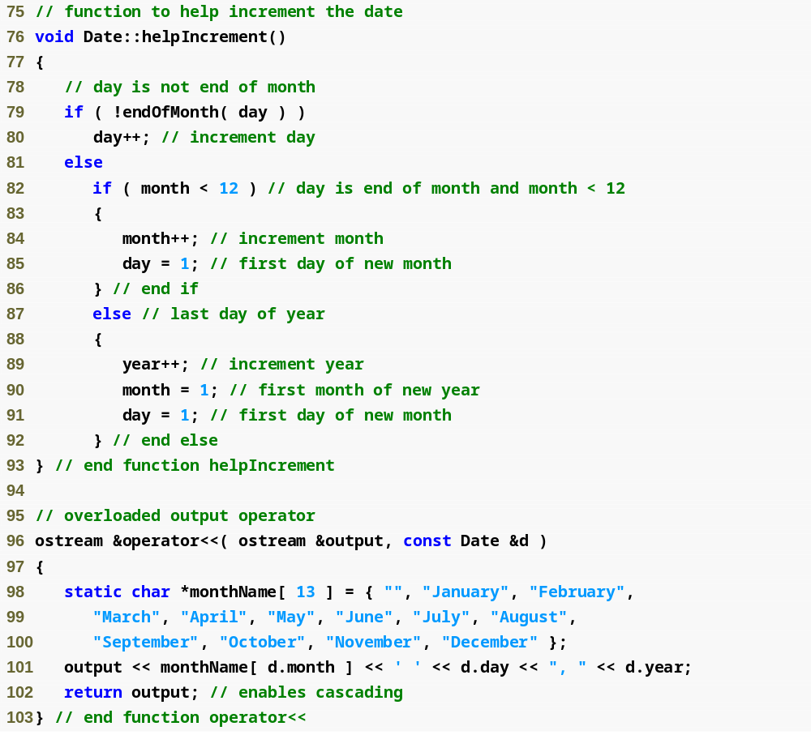
Outline
Date.cpp
(4 of 4)

Slide 92
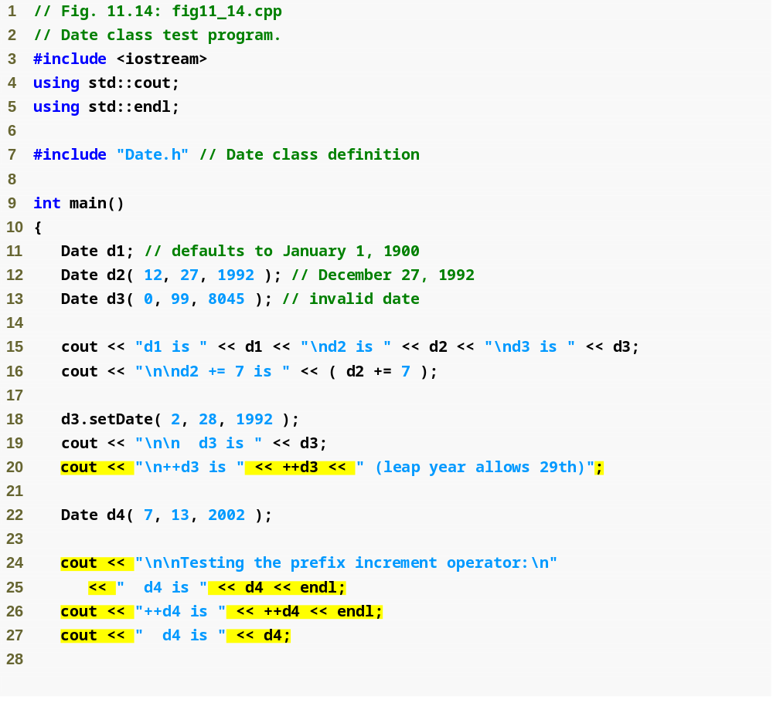
Outline
fig11_14.cpp
(1 of 2)
Demonstrate prefix increment

Slide 93
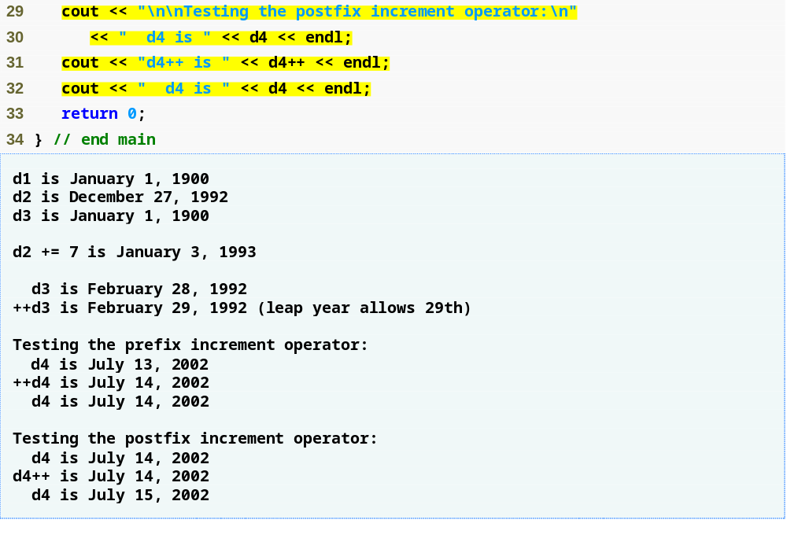
Outline
Demonstrate postfix increment
fig11_14.cpp
(2 of 2)

Slide 94
11.13 Standard Library Class string
Class built into C++
  Available for anyone to use
  Class string
    Similar to our String class
Redo our String example using string

Slide 95
11.13 Standard Library Class string (Cont.)
Class string
  Header <string>, namespace std
  Can initialize string s1( "hi" );
  Overloaded << (as in cout << s1)
  Overloaded relational operators
    ==, !=, >=, >, <=, <
  Assignment operator =
  Concatenation (overloaded +=)

Slide 96
11.13 Standard Library Class string (Cont.)
Class string (Cont.)
  Substring member function substr
    s1.substr( 0, 14 );
      Starts at location 0, gets 14 characters
    s1.substr( 15 );
      Substring beginning at location 15, to the end
  Overloaded []
    Access one character
    No range checking (if subscript invalid)
  Member function at
    Accesses one character
      Example
        s1.at( 10 );
    Has bounds checking, throws an exception if subscript is invalid
      Will end program (learn more in Chapter 16)

Slide 97
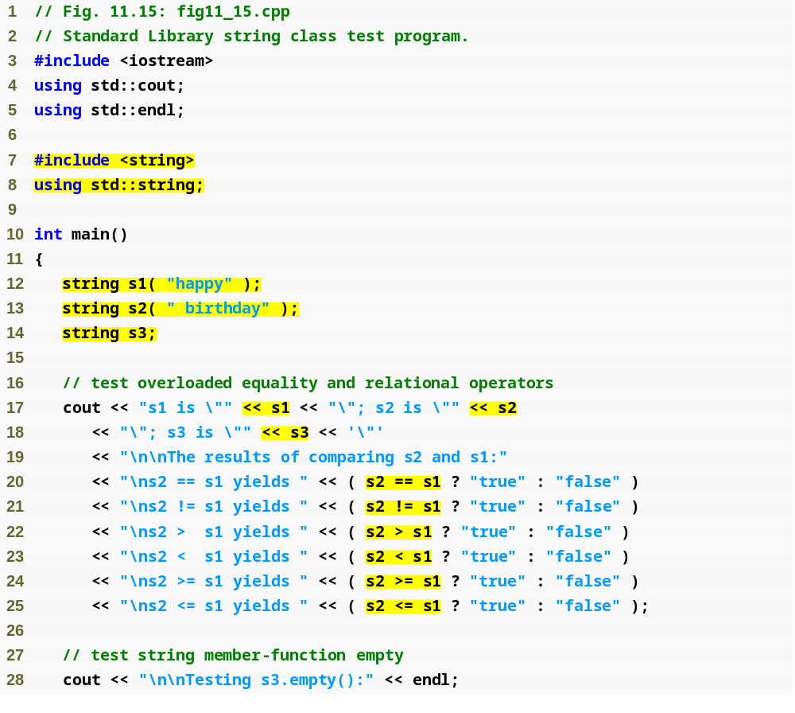
Outline
fig11_15.cpp
(1 of 4)
Passing strings to the string constructor
Create empty string

Slide 98
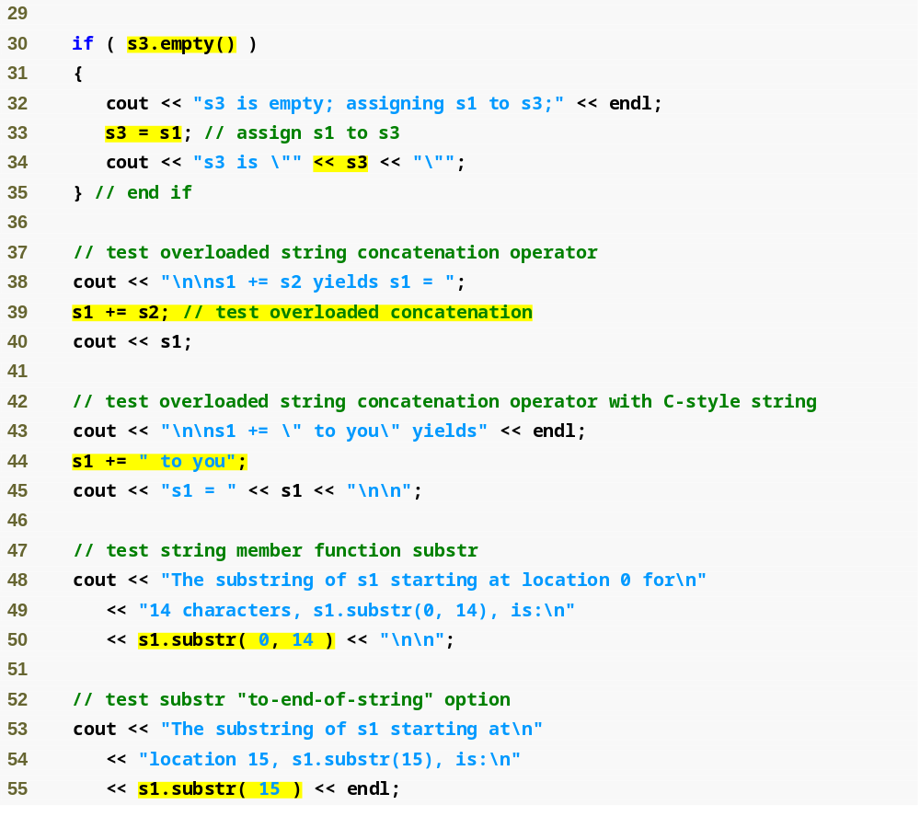
Outline
Member function empty tests if the string is empty
fig11_15.cpp
(2 of 4)
Member function substr obtains a substring from the string

Slide 99
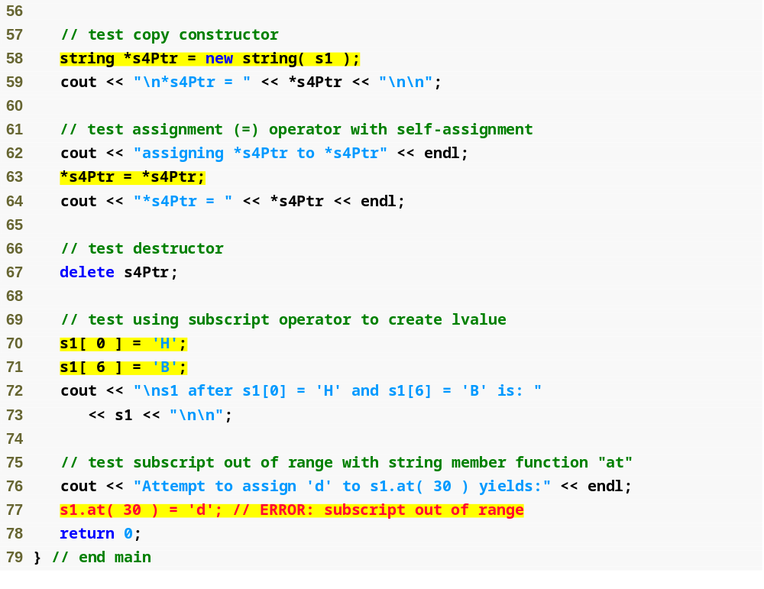
Outline
fig11_15.cpp
(3 of 4)
Accessing specific character in string
Member function at provides range checking

Slide 100
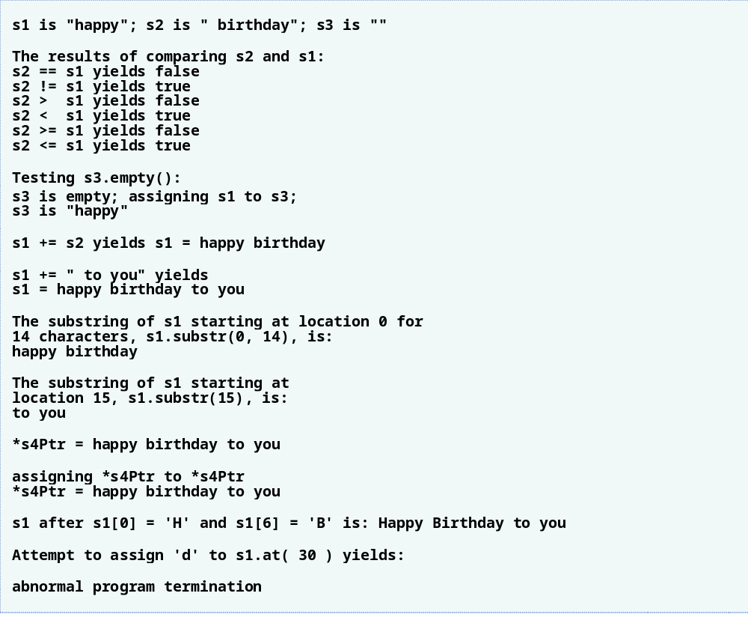
Outline
fig11_15.cpp
(4 of 4)

Slide 101
11.14 explicit Constructors
Implicit conversions
  Performed by compiler using single-argument constructors
  Sometimes, implicit conversions are undesirable or error-prone
    Keyword explicit
      Suppresses implicit conversions via conversion constructors

Slide 102
Common Programming Error 11.9
Unfortunately, the compiler might use implicit conversions in cases that you do not expect, resulting in ambiguous expressions that generate compilation errors or resulting in execution-time logic errors.

Slide 103
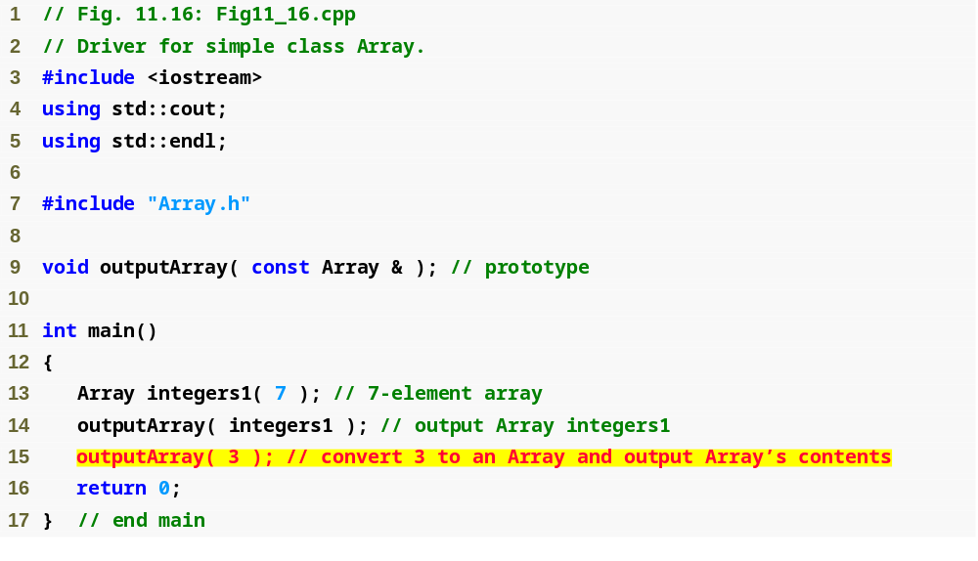
Outline
fig11_16.cpp
(1 of 2)
Would logically want this to generate an error

Slide 104
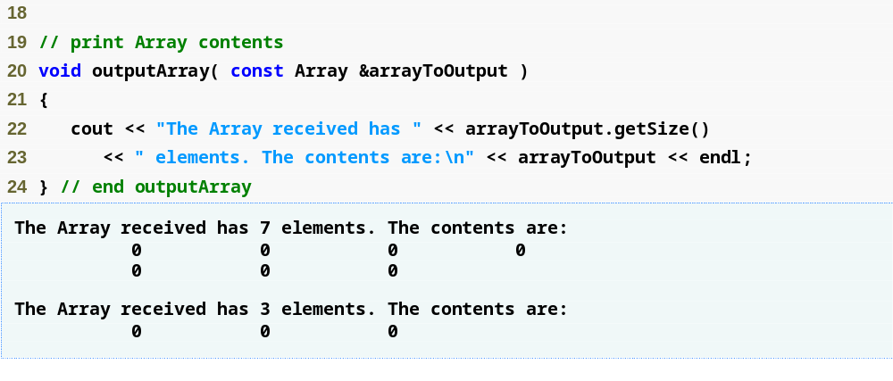
Outline
fig11_16.cpp
(2 of 2)

Slide 105
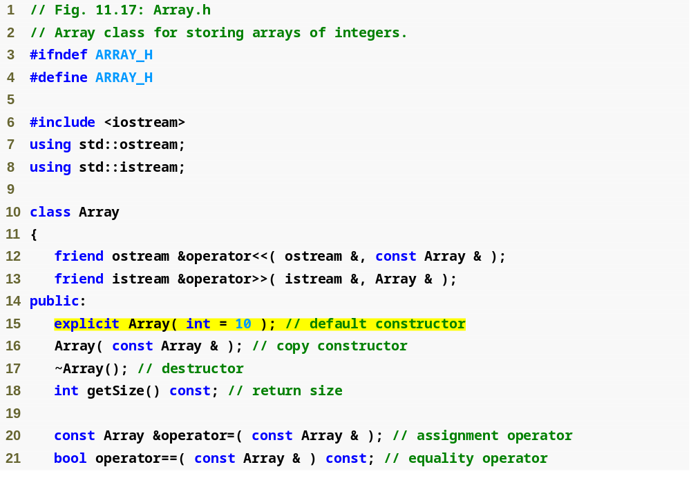
Outline
Array.h
(1 of 1)
Use explicit keyword to avoid implicit conversions when inappropriate

Slide 106
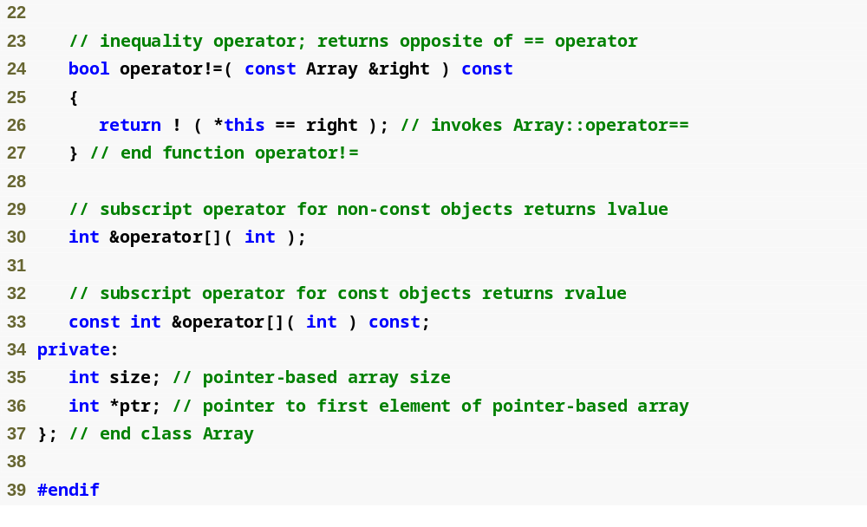
Outline
Array.h
(2 of 2)

Slide 107
Common Programming Error 11.10
Attempting to invoke an explicit constructor for an implicit conversion is a compilation error.

Slide 108
Common Programming Error 11.11
Using the explicit keyword on data members or member functions other than a single-argument constructor is a compilation error.

Slide 109
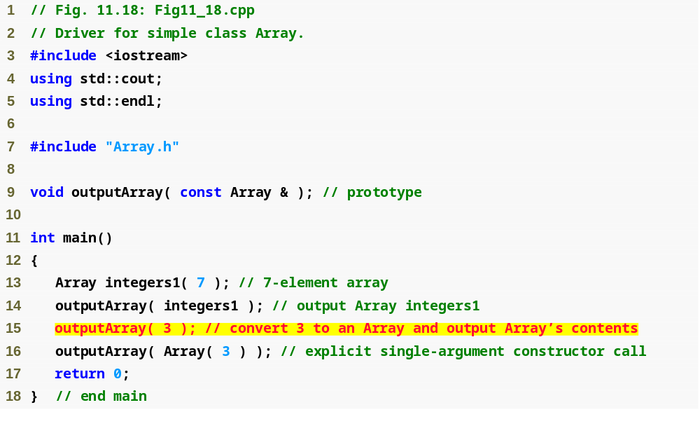
Outline
Fig11_18.cpp
(1 of 2)
Using keyword explicit on the conversion constructor disallows this line to erroneously call the conversion constructor
An explicit call to the conversion constructor is still allowed

Slide 110
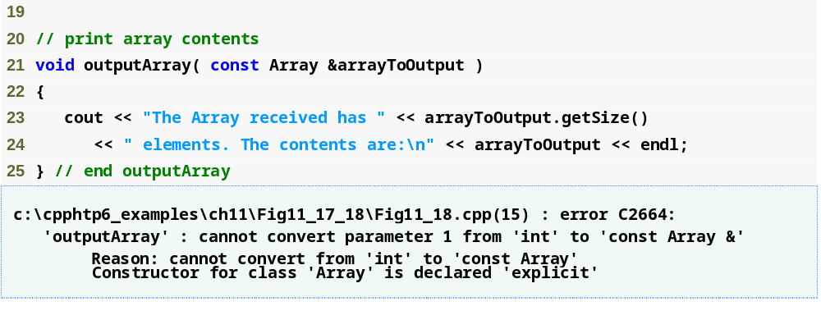
Outline
Fig11_18.cpp
(2 of 2)

Slide 111
Error-Prevention Tip 11.3
Use the explicit keyword on single-argument constructors that should not be used by the compiler to perform implicit conversions.

